Slide 1

Anonymity in XIA
Nicolas Feltman
David Naylor

Slide 2
Goals
Examine existing methods
Does XIA break anything?
Explore new methods
What new things does xia let us do?
Consider users and developers
How can we help developers leverage these tools?
How can we help users understand them?

Slide 3
(Brief) XIA Review
Multiple communication principals
e.g., hosts, services, and content
DAG-based addressing
Affords sender some control over routing
Allows fallbacks to be gracefully implemented
SID
AD
HID

Slide 4


Existing Approach: Proxy
DEST: 187.14.2.1
SRC: 128.144.0.17
DEST: 89.22.22.11
DEST: 89.22.22.11
SRC: 187.14.2.1
REQUEST
REQUEST
128.144.0.17
DEST: 128.144.0.17
187.14.2.1
89.22.22.11
DEST: 187.14.2.1
SRC: 187.14.2.1
SRC: 89.22.22.11
SRC: 89.22.22.11
RESPONSE
RESPONSE

Slide 5
Existing Approach: Proxy
DEST:
AD_{P}
HID_{P}
SID_{P}
SRC:
DEST:
AD_{C}
HID_{C}
SID_{C}
AD_{S}
HID_{S}
SID_{S}
DEST:
SRC:
AD_{S}
HID_{S}
SID_{S}
AD_{P}
HID_{P}
SID_{P}
REQUEST
REQUEST
C
C
C
DEST:
P
P
P
DEST:
S
S
S
AD_{C}
HID_{C}
SID_{C}
AD_{P}
HID_{P}
SID_{P}
SRC:
SRC:
AD_{P}
HID_{P}
SID_{P}
AD_{S}
HID_{S}
SID_{S}
SRC:
RESPONSE
AD_{S}
HID_{S}
SID_{S}
RESPONSE

Slide 6
Existing Approach: Proxy
With DAGs, we can be cleaner
We can express our intent to have a packet sent first through an anonymizer, then to the final destination
SID_{P}
SID_{S}
AD_{P}
HID_{P}
AD_{S}
HID_{S}
PROXY
SERVER

Slide 7
Existing Approach: Proxy
DEST:
DEST:
SID_{P}
SID_{S}
SID_{S}
SRC:
SRC:
AD_{C}
HID_{C}
SID_{C}
AD_{P}
HID_{P}
SID_{P}
REQUEST
REQUEST
C
C
C
DEST:
P
P
P
DEST:
S
S
S
AD_{C}
HID_{C}
SID_{C}
AD_{P}
HID_{P}
SID_{P}
SRC:
SRC:
AD_{P}
HID_{P}
SID_{P}
AD_{S}
HID_{S}
SID_{S}
RESPONSE
RESPONSE

Slide 8
New Approach: Temporary IDs
Use a temp. service ID in place of host ID
Register temp. SID with local AD
Places trust in local AD instead of remote 3rd party
DEST: …
➔
DEST: …
SRC:
SRC:
AD
HID
AD
SID
…
…

Slide 9
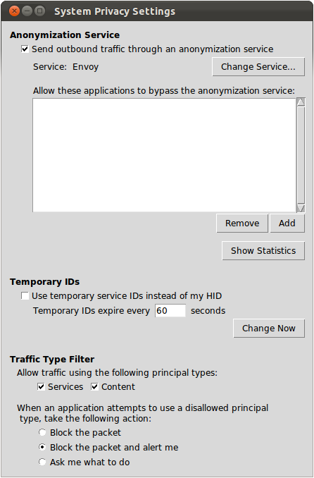
Control and Transparency
Global Controls
Control anonymity
Settings at the OS level
Notes:
Even though it’s not XIA specific, when we’re re-architecting the Internet it’s a good time to build in things users want.

Slide 10
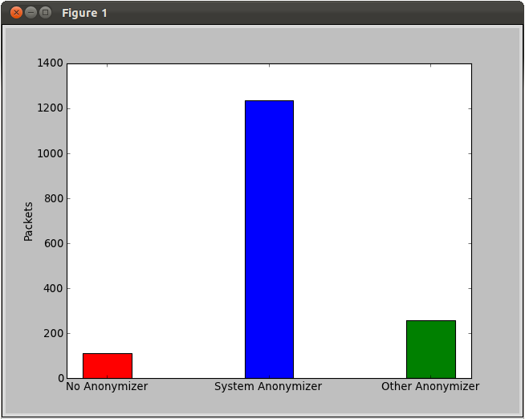
Control and Transparency
Transparency
Users can see exactly
What’s happening
Notes:
Even though it’s not XIA specific, when we’re re-architecting the Internet it’s a good time to build in things users want.

Slide 11
Socket API Extension
Using these tools should be dead-easy for developers
Extend socket API to allow simple setup for anonymous communication
Competent developers should have the power to do more
Applications can request to bypass system anonymization settings
Xconnect(sock, dest_DAG)
XconnectWithAnonymizer(sock, dest_DAG, anon_DAG)
XconnectWithoutAnonymizer(sock, dest_DAG)

Slide 12
Comparison
 | XIA | TCP/IP
Proxy-based anonymizer | In-DAG or next-header | Next-header
Temporary source IDs | Register SID with local AD Fine-grained: different temp. SID per application | Painful with static IP addresses Coarse-grained: one IP address for all processes on machine
Principal type filtering | Fine-grained traffic control | N/A

Slide 13
Demo

Slide 14
Questions?

